Slide 1


SEJAL SUDHIR PATHAK
01-08-2022

Slide 2
Outline
Executive Summary
Introduction
Methodology
Results
Conclusion
Appendix
2

Slide 3
Executive Summary
Summary of methodologies
Data Collection using web scraping and SpaceX API;
Exploratory Data Analysis (EDA), including data wrangling, data visualization and
interactive visual analytics;
Machine Learning Prediction.
Summary of all results
Able to collected valuable data from public sources;
EDA allowed to identify which features are the best to predict success of launchings;
Machine Learning Prediction showed the best model to predict which characteristics
drive this opportunity by the best way, using all collected data.
3

Slide 4
Introduction
Project background and context
Cost of launch continues to remain a key barrier for new competitors in private space travel. SpaceX with its first stage reuse capabilities offers a key advantage against its competitors. Each SpaceX launch costs around $62M and SpaceX can reuse stage 1 for future launches. This provides SpaceX a unique advantage where other competitors are spending around 165 mission plus for each launch.
Problems you want to find answers.
The best way to estimate the total cost for launches, by predicting
successful landings of the first stage of rockets;
Where is the best place to make launches.
4

Slide 5

Section 1
5

Slide 6
Methodology
Executive Summary
Data collection methodology:
SpaceX API
Web scrap Falcon 9 and Falcon Heavy launch records from Wikipedia
Perform data wrangling
Determined labels for training the supervised models by converting mission outcomes in to
training labels (0-unsuccessful, 1-successful)
Perform exploratory data analysis (EDA) using visualization and SQL
Perform interactive visual analytics using Folium and Plotly Dash
Perform predictive analysis using classification models
Created a column for ‘class’; standardized and transformed data; train/test split data; find best
classification algorithm (Logistic regression, SVM, decision tree, & KNN) using test data
6

Slide 7
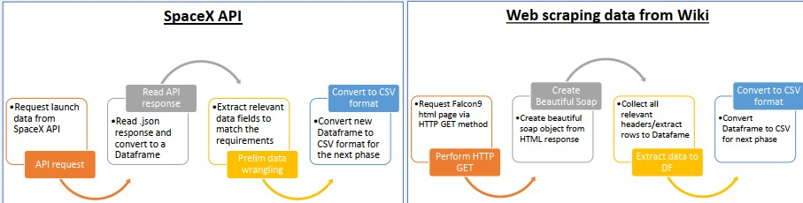
Data Collection
Data sets were collected from Space X API (https://api.spacexdata.com/v4/rockets/) and from Wikipedia using web scraping techniques.
Data collection process use key phrases and flowcharts
7

Slide 8
Data Collection – SpaceX API
Present your data collection with SpaceX REST calls using key phrases and flowcharts
GitHub URL of the completed SpaceX API calls notebook
https://github.com/sejal3009/IBM-Data-Science-Professional-Certificate/blob/main/Applied%20Data%20Science%20Capstone/week%201/jupyter-labs-spacex-data-collection-api-solution.ipynb
8

Slide 9
Data Collection - Scraping
Present your web scraping process using key phrases and flowcharts
GitHub URL of the completed web scraping notebook
https://github.com/sejal3009/IBM-Data-Science-Professional-Certificate/blob/main/Applied%20Data%20Science%20Capstone/week%201/jupyter-labs-webscraping%20solution.ipynb
9

Slide 10
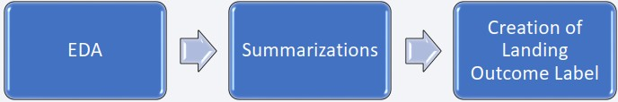
Data Wrangling
Describe how data were processed
Explored data to determine the label for training supervised models
Calculated the number of launches on each site, each orbit, mission outcome per orbit type
Encode a landing outcome from 'Outcome' column, when booster land successfully class =1, otherwise 0.
data wrangling process using key phrases and flowcharts
• GitHub URL of your completed data wrangling related notebooks
https://github.com/sejal3009/IBM-Data-Science-Professional-Certificate/blob/main/Applied%20Data%20Science%20Capstone/week%201/labs-jupyter-spacex-Data%20wrangling%20solution.ipynb

Slide 11
EDA with Data Visualization
Summarize what charts were plotted and why you used those charts
Scatter plot: Shows relationship or correlation between two variables making patterns
easy to observe .
2. Bar Chart: Commonly used to compare the values of a variable at a given point in time. Bar charts makes it easy to see which groups are highest/common and how other groups compare against each other.
3. Line Chart: Commonly used to track changes over a period of time. It helps depict
trends over time.
GitHub URL of your completed EDA with data visualization notebook
https://github.com/sejal3009/IBM-Data-Science-Professional-Certificate/blob/main/Applied%20Data%20Science%20Capstone/week%202/jupyter-labs-eda-dataviz%20soluion.ipynb

Slide 12
EDA with SQL
Using bullet point format, summarize the SQL queries you performed
Names of the unique launch sites in the space mission;
Top 5 launch sites whose name begin with the string 'CCA’;
Total payload mass carried by boosters launched by NASA (CRS);
Average payload mass carried by booster version F9 v1.1;
Date when the first successful landing outcome in ground pad was achieved;
Names of the boosters which have success in drone ship and have payload mass between 4000 ~ 6000 kg;
Total number of successful and failure mission outcomes;
Names of the booster versions which have carried the maximum payload mass;
Failed landing outcomes in drone ship, their booster versions, and launch site names for in year 2015; and
GitHub URL of your completed EDA with SQL notebook
https://github.com/sejal3009/IBM-Data-Science-Professional-Certificate/blob/main/Applied%20Data%20Science%20Capstone/week%202/jupyter-labs-eda-sql-coursera_sqllite%20(1).ipynb
12

Slide 13
Build an Interactive Map with Folium
Summarize what map objects created and added to a folium map and explain why.
Folium interactive map helps analyze geospatial data to perform more interactive visual analytics and
better understand factors such location and proximity of launch sites that impact launch success rate.
Map objects created and added to the map:
Mark all launch sites on the map. This allowed to visually see the launch sites on the map.
Added ‘folium.circle’ and ‘folium.marker’ to highlight circle area with a text label over each launch site.
Added a ‘MarkerCluster()’ to show launch success (green) and failure (red) markers for each launch site.
Calculated distances between a launch site to its proximities (e.g., coastline, railroad, highway, city)
GitHub URL of your completed interactive map with Folium map
https://github.com/sejal3009/IBM-Data-Science-Professional-Certificate/blob/main/Applied%20Data%20Science%20Capstone/week%203/lab_jupyter_launch_site_location%20solution.ipynb

Slide 14
Build a Dashboard with Plotly Dash
Summarize what plots/graphs and interactions you have added to a dashboard and explain why.
- Added Launch Site Drop-down, Pie Chart, Payload range slide, and a Scatter chart to the Dashboard.
Launch Site Drop-down Input component to the dashboard to provide an ability to filter Dashboard visual by all launch sites or a particular launch site
Pie Chart to the Dashboard to show total success launches when ‘All Sites’ is selected and show success
and failed counts when a particular site is selected
Payload range slider to the Dashboard to easily select different payload ranges to identify visual patterns
Scatter chart to observe how payload may be correlated with mission outcomes for selected site(s). The
color-label Booster version on each scatter point provided missions outcomes with different boosters
GitHub URL of your completed Plotly Dash lab
https://github.com/sejal3009/IBM-Data-Science-Professional-Certificate/blob/main/Applied%20Data%20Science%20Capstone/week%203/spacex_dash_app.py

Slide 15
Predictive Analysis (Classification)
Summarize how you built, evaluated, improved, and found the best performing classification model
- 4 classification models were compared: logistic regression, support vector machine, decision tree and k nearest neighbors.
You need present your model development process using key phrases and flowchart
GitHub URL of your completed predictive analysis lab: https://github.com/sejal3009/IBM-Data-Science-Professional-Certificate/blob/main/Applied%20Data%20Science%20Capstone/week%204/SpaceX_Machine%20Learning%20Prediction_Part_5%20solution.ipynb

Slide 16
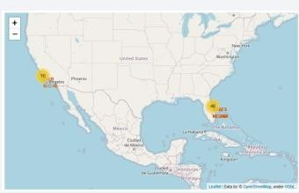
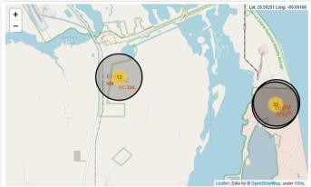
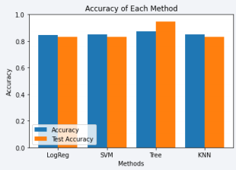
Results
Exploratory data analysis results
Space X uses 4 different launch sites. The 1st launches happened in 2010 (Space X and NASA), the 1st success landing outcome was in 2015.
Many Falcon 9 booster versions were successful at landing in drone ships having payload above the average;
Two booster versions failed at landing in drone ships in 2015: F9 v1.1 B1012 and F9 v1.1 B1015. The number of landing outcomes became as better as years passed.
Interactive analytics demo in screenshots
- Using interactive analytics was possible to identify that launch sites use to be in safety places, near sea, for example and
have a good logistic infrastructure around. Most launches happens at east cost launch sites.
Predictive analysis results
- Decision Tree Classifier is the best model to predict successful landings, over 87% and accuracy for test data over 94%.
having accuracy
16

Slide 17

Section 2

Slide 18
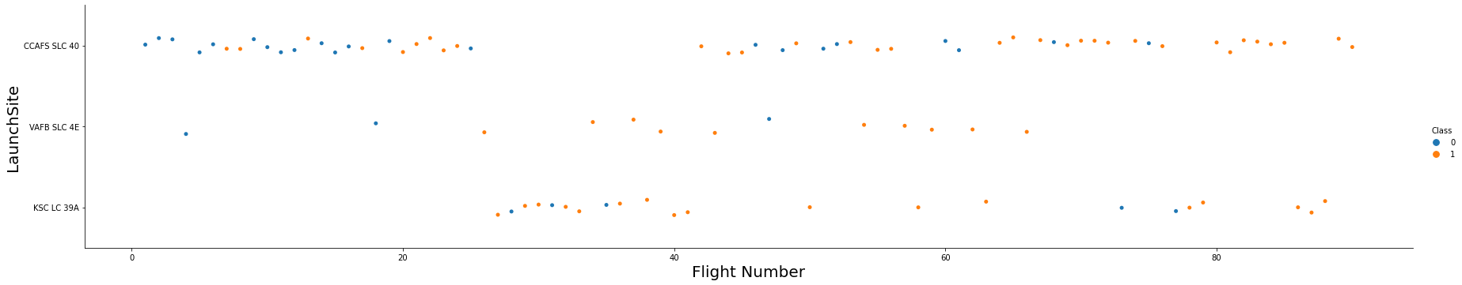
Flight Number vs. Launch Site
Show a scatter plot of Flight Number vs. Launch Site
Show the screenshot of the scatter plot with explanations
It’s possible to verify that the best launch site nowadays is CCAF5 SLC 40, second place VAFB SLC 4E
and third place KSC LC 39A;
The general success rate improved over time.

Slide 19
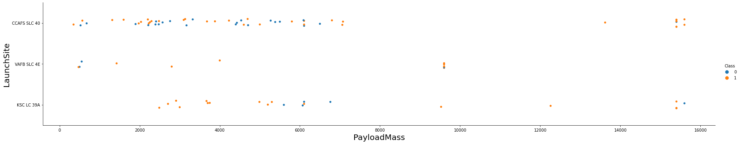
Payload vs. Launch Site
Show a scatter plot of Payload vs. Launch Site
Show the screenshot of the scatter plot with explanations
- Payloads over 9,000kg (about the weight of a school bus) have excellent success rate;
- Payloads over 12,000kg seems to be possible only on CCAFS SLC 40 and KSC LC 39A launch sites.

Slide 20
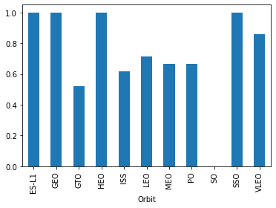
Success Rate vs. Orbit Type
Show a bar chart for the success rate of each orbit type
Show the screenshot of the scatter plot with explanations
- The biggest success rates happens to orbits ranking:
ES-L1;
GEO;
HEO;
SSO;
VLEO (above 80%);
LFO (above 70%).

Slide 21
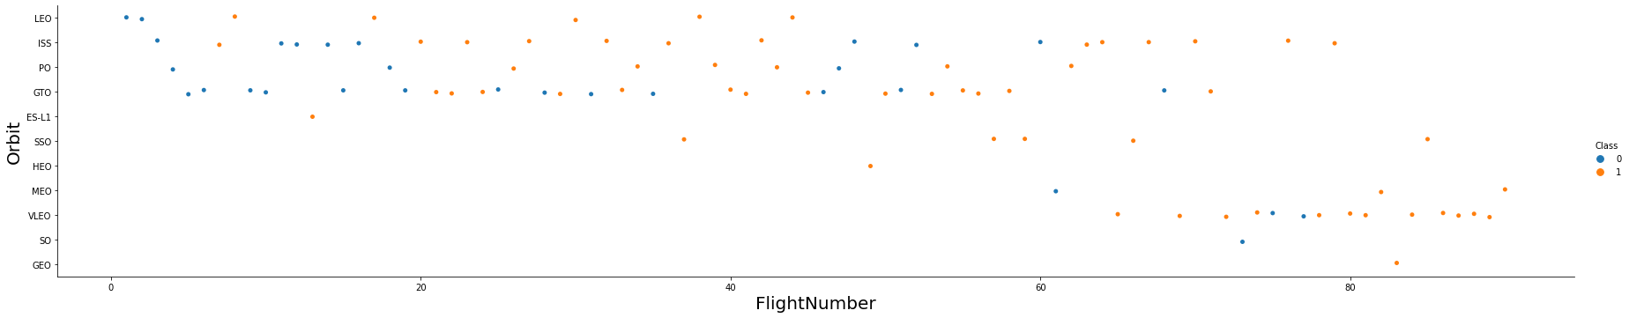
Flight Number vs. Orbit Type
Show a scatter point of Flight number vs. Orbit type
Show the screenshot of the scatter plot with explanations
Success rate improved over time to all orbits.
VLEO orbit seems a new business opportunity, due to recent increase of its frequency
For most orbits (LEO, ISS, PO, SSO, MEO, VLEO) successful landing rates appear to increase with flight numbers
- There is no relationship between flight number and orbit for GTO
21

Slide 22
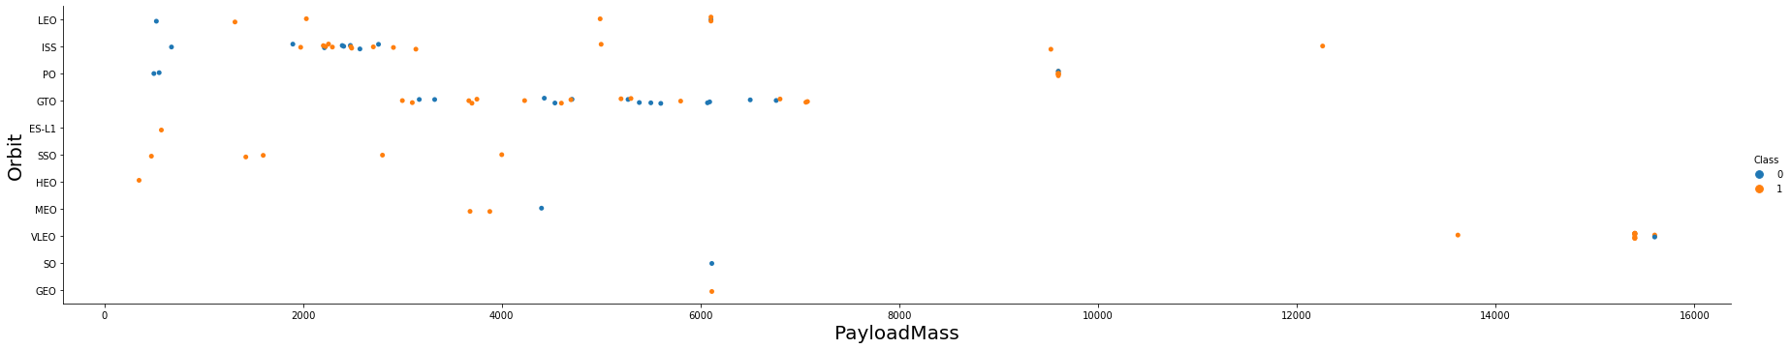
Payload vs. Orbit Type
Show a scatter point of payload vs. orbit type
Show the screenshot of the scatter plot with explanations
There is no relation between payload and success rate to orbit GTO
ISS orbit has the widest range of payload and a good rate of success
There are few launches to the orbits SO and GEO.
22

Slide 23
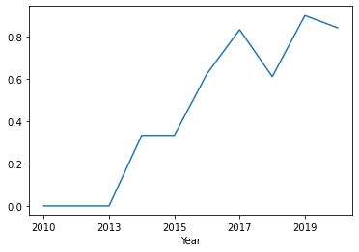
Launch Success Yearly Trend
Show a line chart of yearly average success rate
Show the screenshot of the scatter plot with explanations
Success rate (Class=1) increased by about 80% between 2013 and 2020
Success rates remained the same between 2010 and 2013 and between 2014 and 2015
Success rates decreased between 2017 and 2018 and between 2019 and
2020

Slide 24
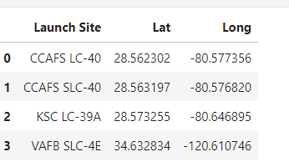
All Launch Site Names
Find the names of the unique
launch sites
Present your query result with a short explanation here
here is no relation between payload and success rate to orbit GTO;
ISS orbit has the widest range of payload and a
good rate of success;
There are few launches to the orbits SO and GEO.

Slide 25
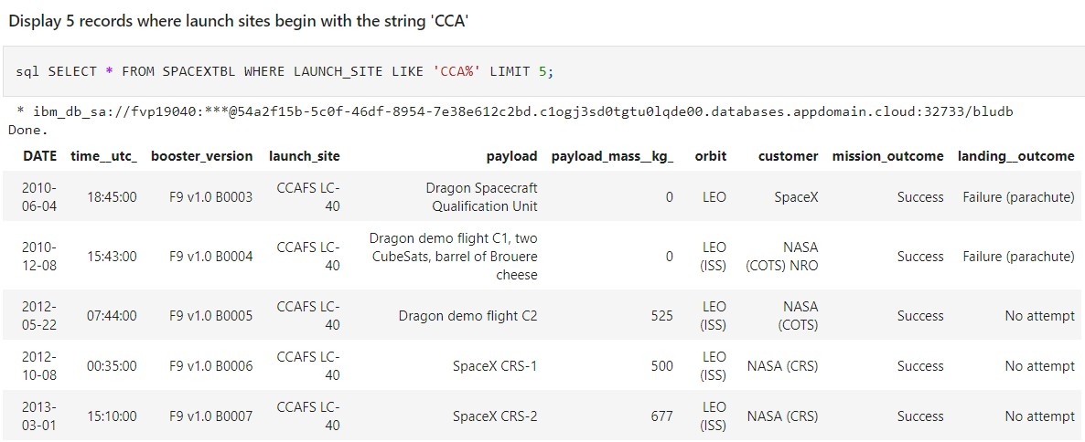
Launch Site Names Begin with 'CCA'
Find 5 records where launch sites begin with `CCA`
Present your query result with a short explanation here

Slide 26
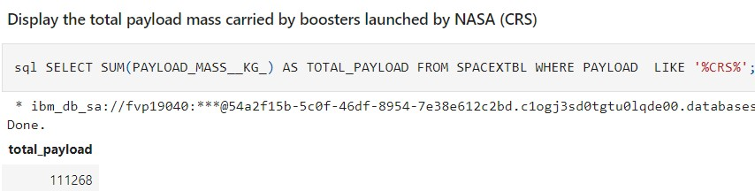
Total Payload Mass
Calculate the total payload carried by boosters from NASA
Present your query result with a short explanation here

Slide 27
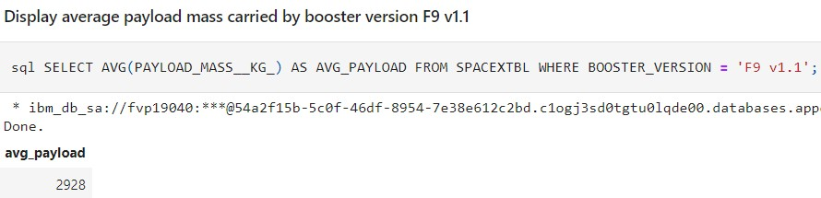
Average Payload Mass by F9 v1.1
Calculate the average payload mass carried by booster version F9 v1.1
Present your query result with a short explanation here

Slide 28
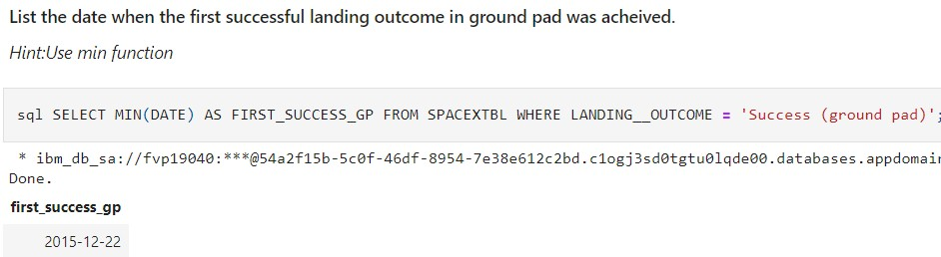
First Successful Ground Landing Date
Find the dates of the first successful landing outcome on ground pad
Present your query result with a short explanation here

Slide 29
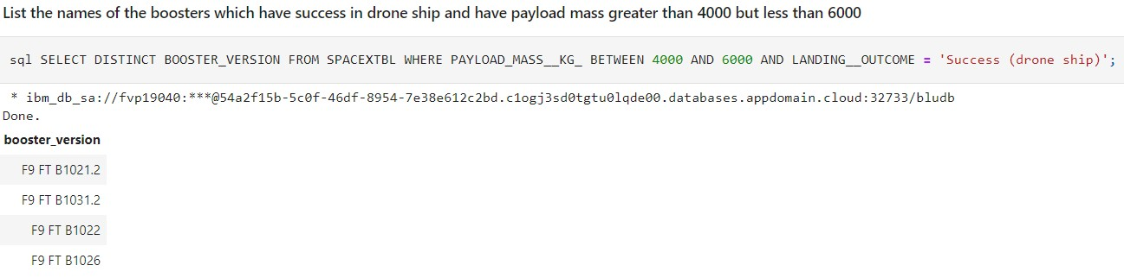
Successful Drone Ship Landing with Payload between 4000 and 6000
List the names of boosters which have successfully landed on drone ship and had payload mass greater than 4000 but less than 6000
Present your query result with a short explanation here

Slide 30
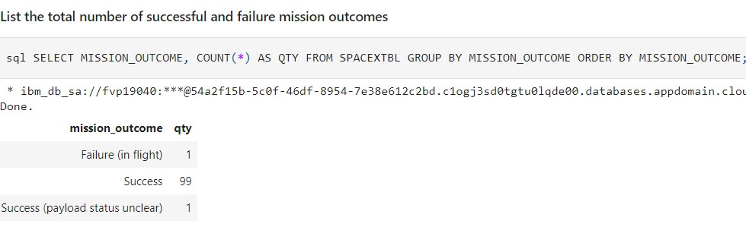
Total Number of Successful and Failure Mission Outcomes
Calculate the total number of successful and failure mission outcomes
Present your query result with a short explanation here

Slide 31
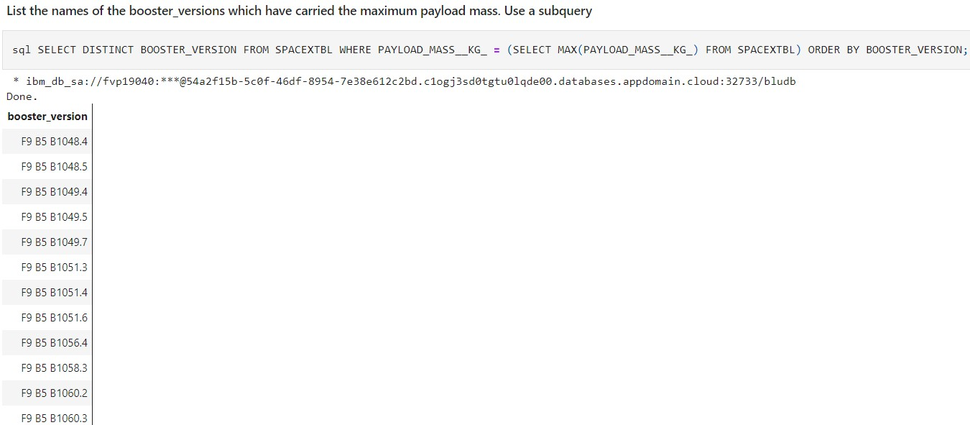
Boosters Carried Maximum Payload
List the names of the booster which have carried the maximum payload mass

Slide 32
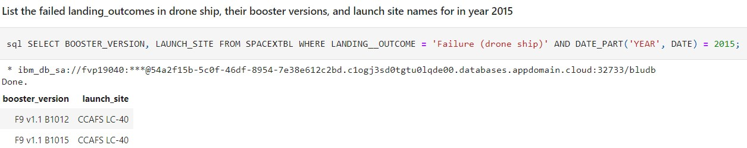
2015 Launch Records
List the failed landing_outcomes in drone ship, their booster versions, and launch site names for in year 2015
Present your query result with a short explanation here

Slide 33
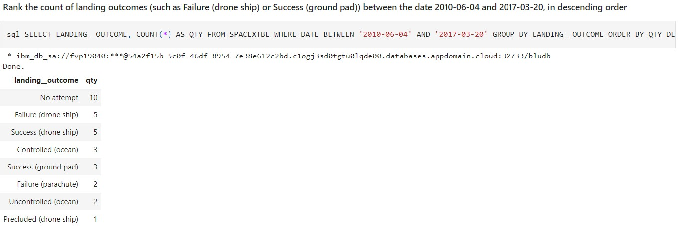
Rank Landing Outcomes Between 2010-06-04 and 2017-03-20
Rank the count of landing outcomes (such as Failure (drone ship) or Success (ground pad)) between the date 2010-06-04 and 2017-03-20, in descending order

Slide 34

Section 3

Slide 35
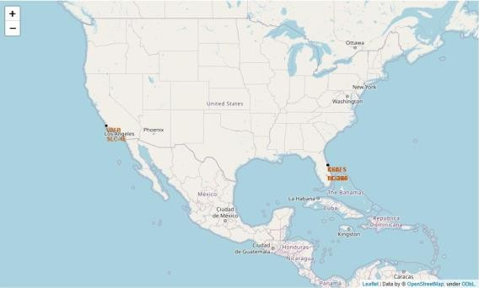
SpaceX Falcon9 - Launch Sites Map
Explore the generated folium map and make a proper screenshot to include all launch sites’ location markers on a global map
Each launch site contains a circle, label, and a popup to highlight the location and the name of the launch site.
all launch sites are near the coast.

Slide 36
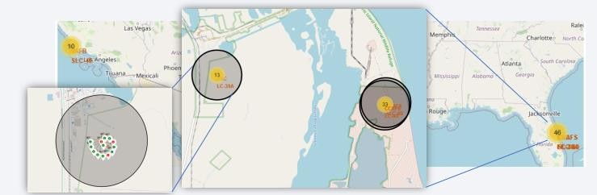
Launch Outcomes by Site
Explain the important elements and findings on the screenshot
The US map with all the Launch Sites. The numbers on each site depict the total number of successful and failed launches
By looking at each site map, KSC LC-39A Launch Site has the greatest number of successful launches

Slide 37
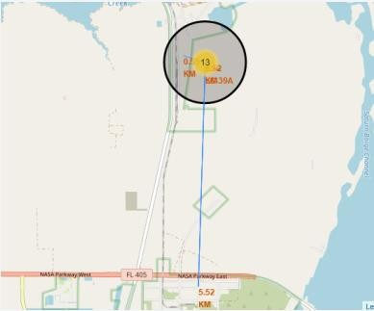
Logistics and Safety
Explain the important elements and
findings on the screenshot
- Launch site KSC LC-39A has good logistics aspects, being near railroad and road and
relatively far from inhabited areas

Slide 38

Section 4

Slide 39
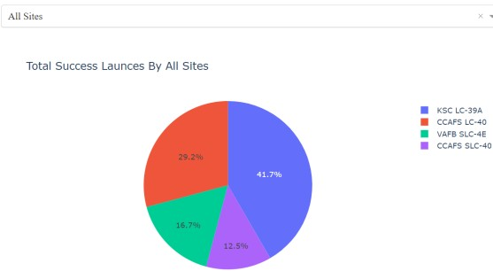
Launch Success Counts For All Sites
Explain the important elements and findings on the screenshot
Launch Site ‘KSC LC-39A’ has the highest launch success rate
Launch Site ‘CCAFS SLC-40’ has the lowest launch success rate
39

Slide 40
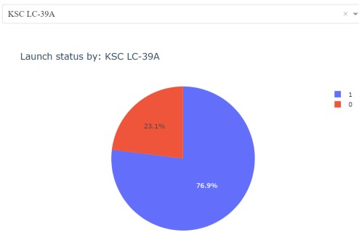
Launch Site with Highest Launch Success Ratio
Explain the important elements and findings on the screenshot
- KSC LC-39A Launch Site has the highest launch success rate and count
- Launch success rate is 76.9%， Launch success failure rate is 23.1%
40

Slide 41
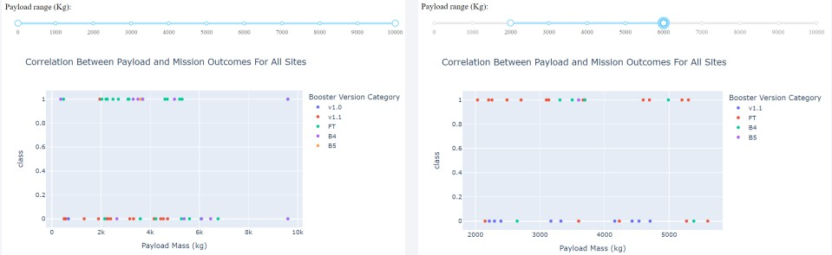
Payload vs. Launch Outcome Scatter Plot for All Sites
Explain the important elements and findings on the screenshot, such as which payload range or booster version have the largest success rate, etc.
Most successful launches are in the payload range from 2000 to about 5500
Booster version category ‘FT’ has the most successful launches
Only booster with a success launch when payload is greater than 6k is ‘B4’
41

Slide 42

Section 5

Slide 43
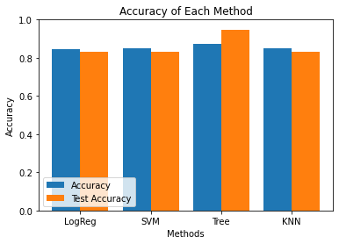
Classification Accuracy
Visualize the built model accuracy for all
built classification models, in a bar chart
Find which model has the highest
classification accuracy
4 classification models were tested, and their accuracies are plotted beside
The model with the highest classification accuracy is Decision Tree Classifier, which has accuracies over than 87%

Slide 44
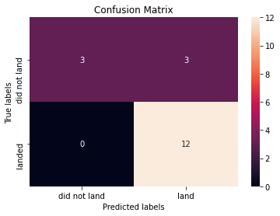
Confusion Matrix
Show the confusion matrix of the best performing model with an explanation
The confusion matrix is same for all the models (LR, SVM, Decision Tree, KNN)
Per the confusion matrix, the classifier made 18 predictions
12 scenarios were predicted Yes for landing, and they did land successfully (True positive)
3 scenarios (top left) were predicted No for landing, and they did not land (True negative)
3 scenarios (top right) were predicted Yes for landing, but they did not land successfully (False positive)
Overall, the classifier is correct about 83% of the time ((TP + TN) / Total) with a misclassification or error rate ((FP + FN) / Total) of about 16.5%

Slide 45
Conclusions
Different data sources were analyzed, refining conclusions along the process
Launches above 7,000kg are less risky
Although most of mission outcomes are successful, successful landing outcomes seem to improve over time, according the evolution of processes and rockets
Launch Site ‘KSC LC-39A’ has the highest launch success rate and Launch Site ‘CCAFS SLC-40’ has
the lowest launch success rate
Orbits ES-L1, GEO, HEO, and SSO have the highest launch success rates and orbit GTO the lowest
Lunch sites are located strategically away from cities and closer to coastline, railroads & highways
The best performing Machine Learning Classfication Model is the Decision Tree with an accuracy of about 87.5%.

Slide 46
Appendix
Include any relevant assets like Python code snippets, SQL queries, charts,
Notebook outputs, or data sets that you may have created during this project

Slide 47


